Slide 1
Card matching game
Games Design Pattern
Name:Youmeng Li
ID:0528314
Email:yli11@lakeheadu.ca

Slide 2
Game Rules
Click any card to turn it over
Each time when you turn over 2 cards, if they are the same one, they will be disappeared. Otherwise, they will turn back again
Keep turning over same pair you can get higher and higher point
Try to finish game by highest point

Slide 3
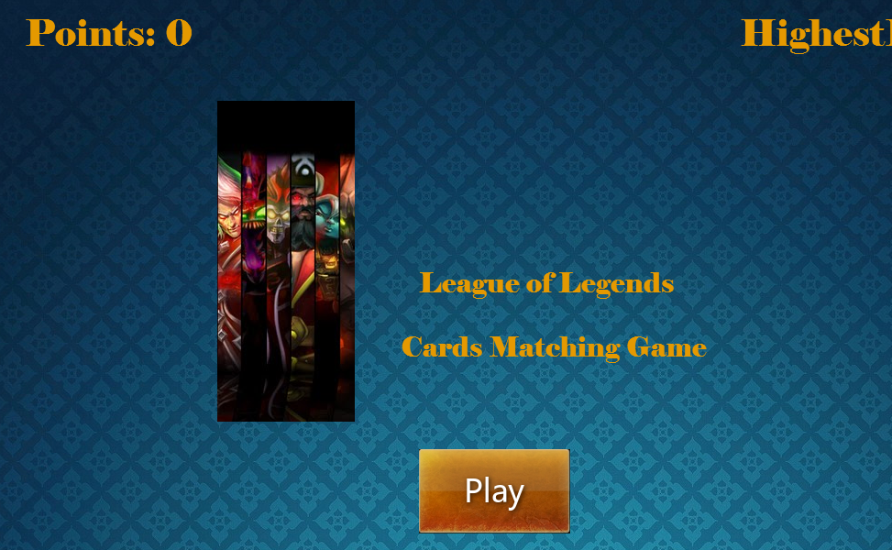
Start Screen

Slide 4
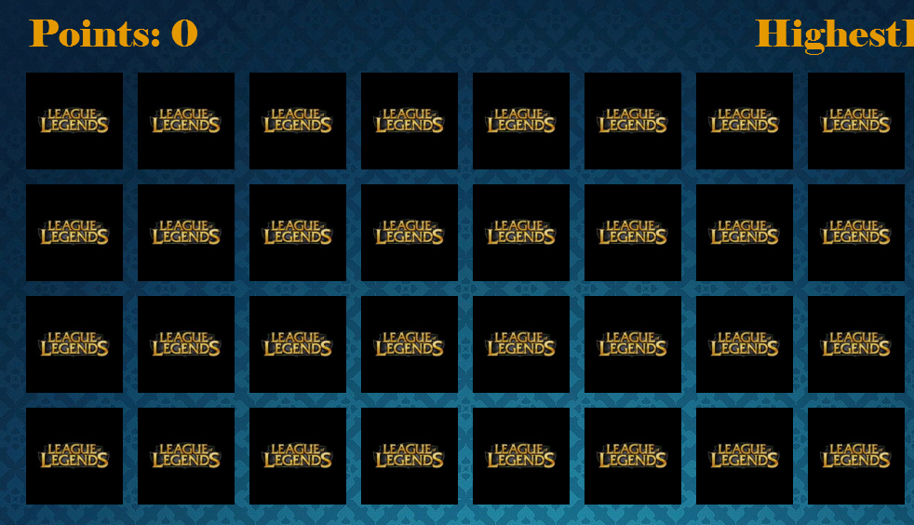
Game Prepared

Slide 5
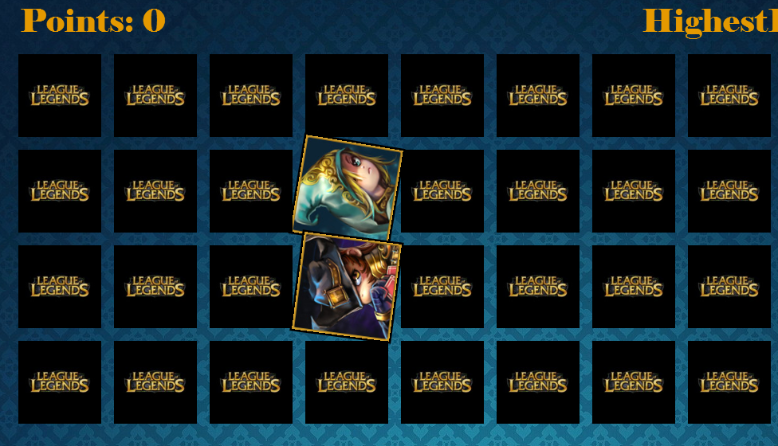
Turn Over Card

Slide 6
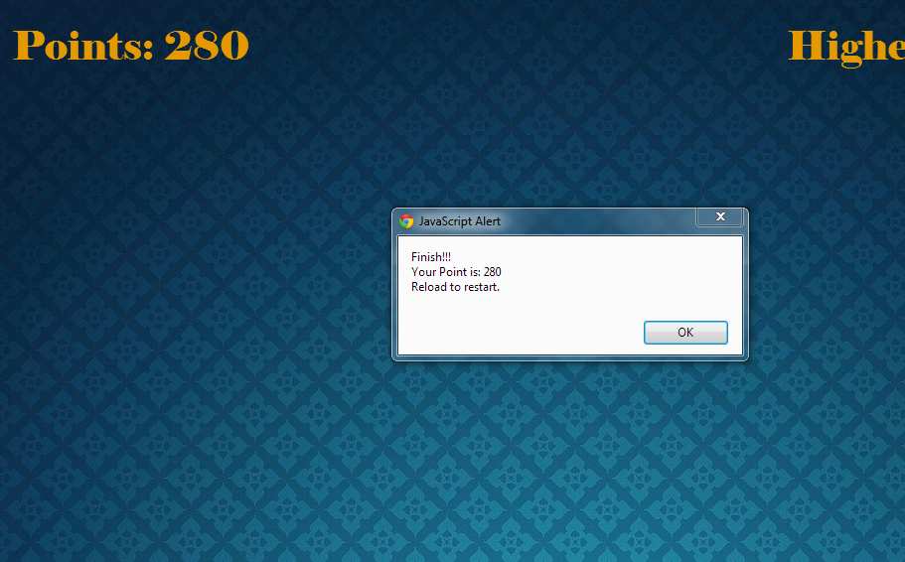
End of Game

